Slide 1
IBM
THE GREAT MIND CHALLENGE 2015
Panimalar Institute of Technology
Project done by:
Srinath G
Hariprakash B
Mithilaesh J

Slide 2
Efficiency of Multimedia Cloud Computing to Save Smart Phone Energy

Slide 3
Abstract:
In spite of the melodramatic development in the number of intelligent phones in present years, the trial of manipulated power capacity of these mechanisms has not been resolved satisfactorily.
However, in the period of cloud computing, the limitation on power capacity can be relieved off in an effectual method by offloading heavy tasks to the cloud.
In this undertaking, we assess the power price of multimedia requests on intelligent phones that are related to Multimedia Cloud Calculating (MCC).
In the counseled arrangement we led an comprehensive set of examinations to compute the power prices to examine whether or not intelligent phones save power by employing MCC services.

Slide 4
Abstract(cont…)
In counseled arrangement we contrasted the power prices for uploading and downloading a multimedia file to and from MCC alongside the power prices of encoding the alike multimedia file on a intelligent phone.
We counsel a novel method for storing a multimedia file like picture, audio, video, text on the cloud to cut number of energy.
Our aftermath display that MCC provides the intelligent phones alongside far multimedia functionality and saves intelligent phone power from 30% to 70%.

Slide 5
Objective of the project:
The main target of our undertaking is to stop defeat of multimedia data's and to dispatch data to cloud storage and user can be able to think the uploaded multimedia data from anywhere.

Slide 6
Literature Review:
M. Altamimi and K. Naik, “The Concept of a Mobile Cloud Computing to Reduce Energy Cost of Smartphone's and ICT Systems,”. ICT-GLOW’11. Berlin, Heidelberg: Springer-Verlag, 2011, pp. 79–86.
In spite of the melodramatic development in the number of intelligent phones in the present years, the power capacity trial for these mechanisms has not been resolved satisfactorily. Moreover, the globe demand for green Data and Contact Knowledge (ICT) motivates the researchers to ponder cloud computing as a new computing paradigm that is enthusing for green solution. In this paper, we counsel new green resolutions that save Smartphone's power and at the alike period accomplish the green ICT goal. Our green resolution is attained by what we call Mobile Cloud Calculating (MCC). The MCC migrates the content from the main cloud data centre to innate cloud data centre temporary. The Internet Service Furnish (ISP) provides the MCC, that holds the needed contents for the Smartphone network. Our scrutiny and examinations display that our counseled resolution considerably reduces the ICT arrangement power consumption by 63% - 70%.

Slide 7
Existing System:
In continuing arrangement we can store multimedia files on the inner or external storage.
The user can think the content merely if storage is available.
If inner or external storage become crashed or removed we can’t reclaim the data.
The user can use manipulated number storage in the mobile phones.

Slide 8
Problem Identification:
User cannot reclaim data if inner or external recollection become removed or crashed.
There is no protection for the user data and anybody can think the data.
If inner or external recollection become excess user could not able to save data.
Extra number of data on intelligent phones will cut presentation and power of the intelligent phones.

Slide 9
Proposed System:
In counseled arrangement the user can be utilized to store data in cloud storage.
The user can open the data anywhere because we are uploading data's in cloud storage.
In counseled arrangement we are employing Offloading method for uploading data into cloud storage.
The user can find the file on cloud storage employing data filter.
In our counseled arrangement user can store and reclaim data lacking the use of mobile storage.

Slide 10
Advantage:
User can upload their confidential files on cloud and think files.
The user can admission the multimedia file from anywhere because it is placed in cloud storage.
User can think the files employing our request itself.
It furnish protection for our confidential multimedia files and supplementary cannot think the files.
User data cannot be capitulated or erased.

Slide 11
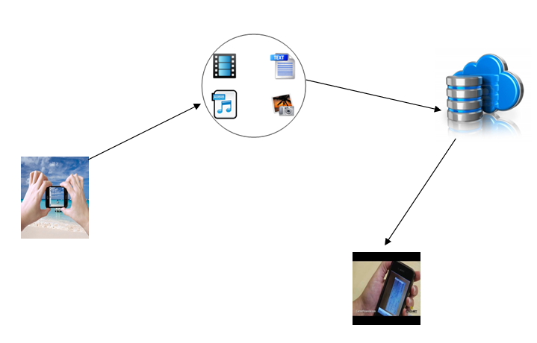
System Architecture:
Uploading the
multimedia files
to cloud storage
Capturing and
Recording Multimedia file using application
Downloading and
viewing files in mobile

Slide 12
Modules Specification:
Login for Cloud Storage
Uploading Multimedia files in Cloud
Searching the file using Date filter
View file on cloud

Slide 13
Login For Cloud Storage:
Cloud storage is utilized to store ,access and grasp file on online.
To upload the multimedia file to cloud storage craft a account on cloud storage. There are disparate kinds of cloud storage is available. Here we are employing Drop Box for storing the multimedia file in cloud storage.
Create a account on the Dropbox and link it alongside our request to sign in for our application.

Slide 14
Uploading Multimedia Files In Cloud:
The main target of our undertaking is to upload multimedia files in cloud storage employing offloading method
Offloading method is generally utilized to upload data to server or cloud employing Cellular and Wifi.
Offloading is an competent method for spreading the lifetime of handheld mobile mechanisms by giving a little constituents of requests remotely.
For the conclude users the intention for acting mobile data offloading is established on data ability price manipulation and potential of higher bandwidth

Slide 15
Searching The File Using Date Filter:
Usually, there are thousands of files stored in our computer, and looking for something in that large a stash is something extremely hard if you have to do it manually. A larger, extra effectual method to gaze for a file is to use a filter tool.
When hunting for files or folders, setting up the proper filters plays a extremely vital act in swiftly discovering the needed file or document.
This date filter lets you apply distinct date for files and sub-files, as well as add specific expansions to exclude from the search.

Slide 16
View File On Cloud:
Using Dropbox Cloud Connect, you can correct a document online. Every single period you sync a document, the revisions of a document are stored so you can facilely roll back to a preceding version. You can go back to each prior revision of a document at each time.
Cloud Files permits users to store/retrieve files via a easy API key.
Users can have nearly unlimited file sizes in Cloud Files by employing our Colossal File Support. This permits clients to upload as countless file as they wish.

Slide 17

Screen Shots :

Slide 18
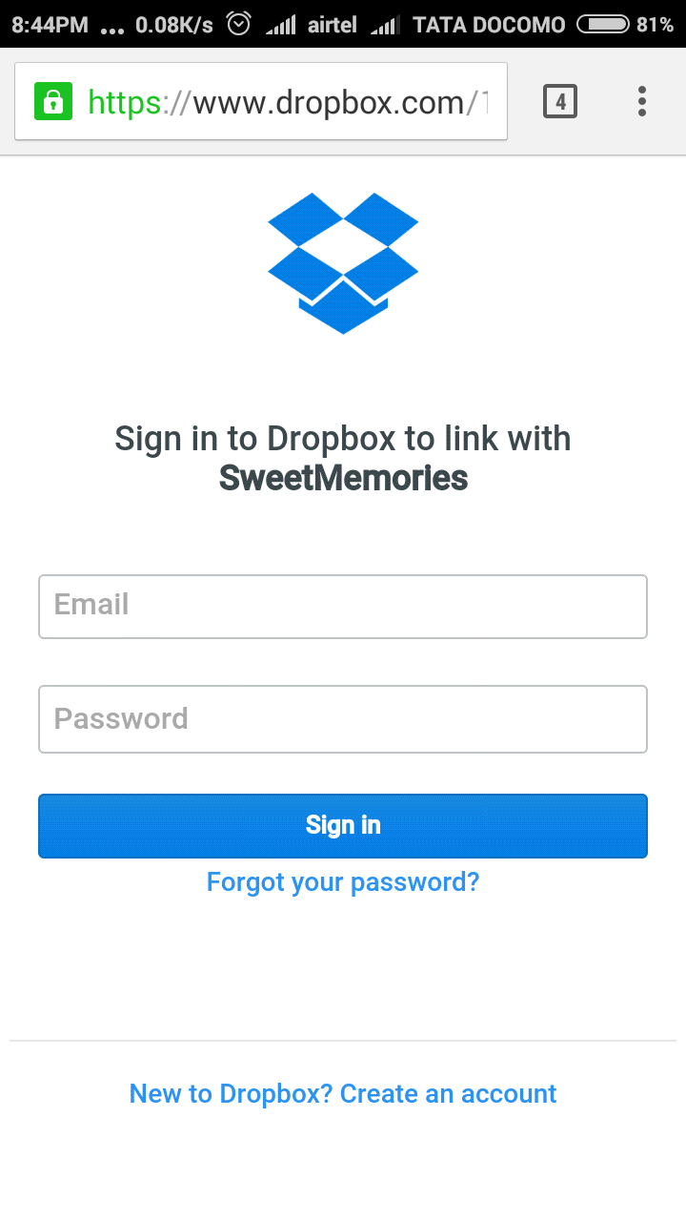

Slide 19
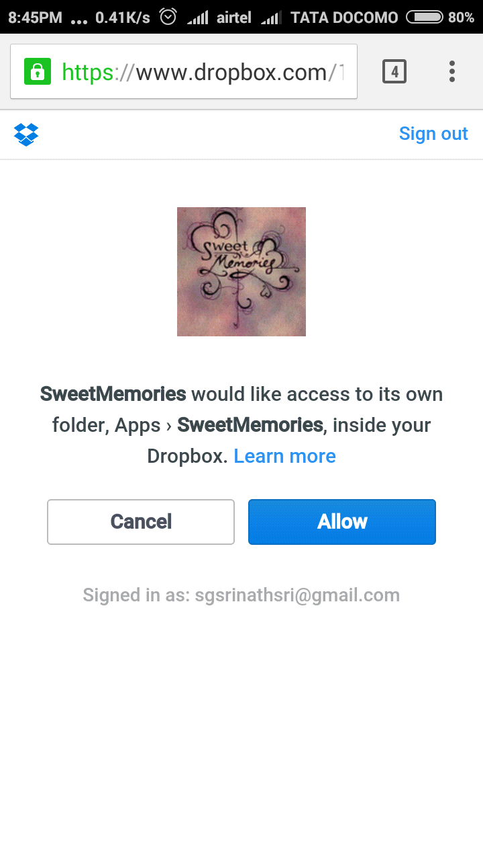

Slide 20
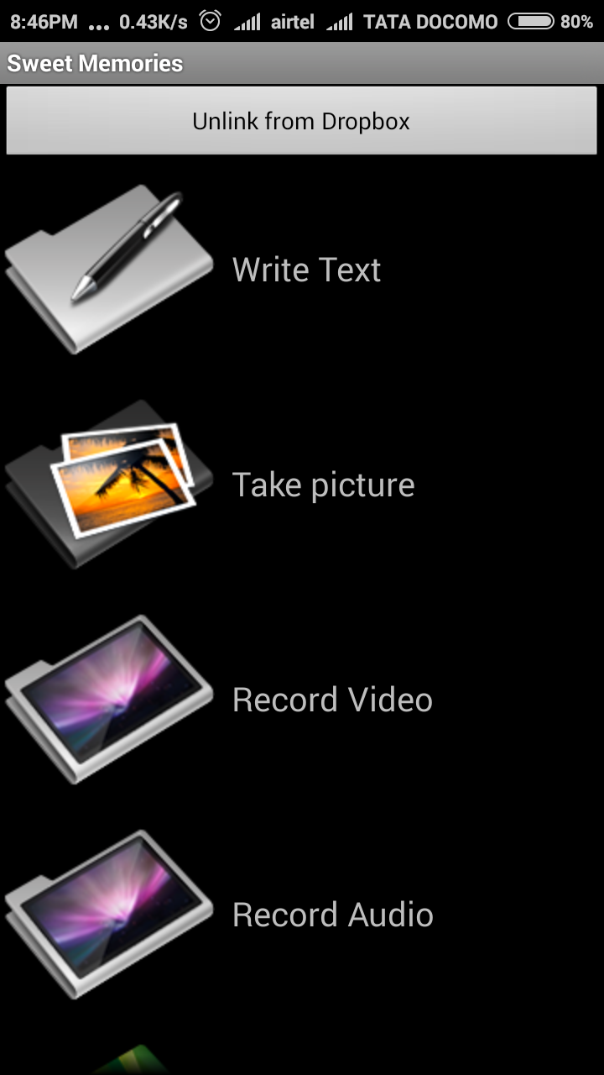
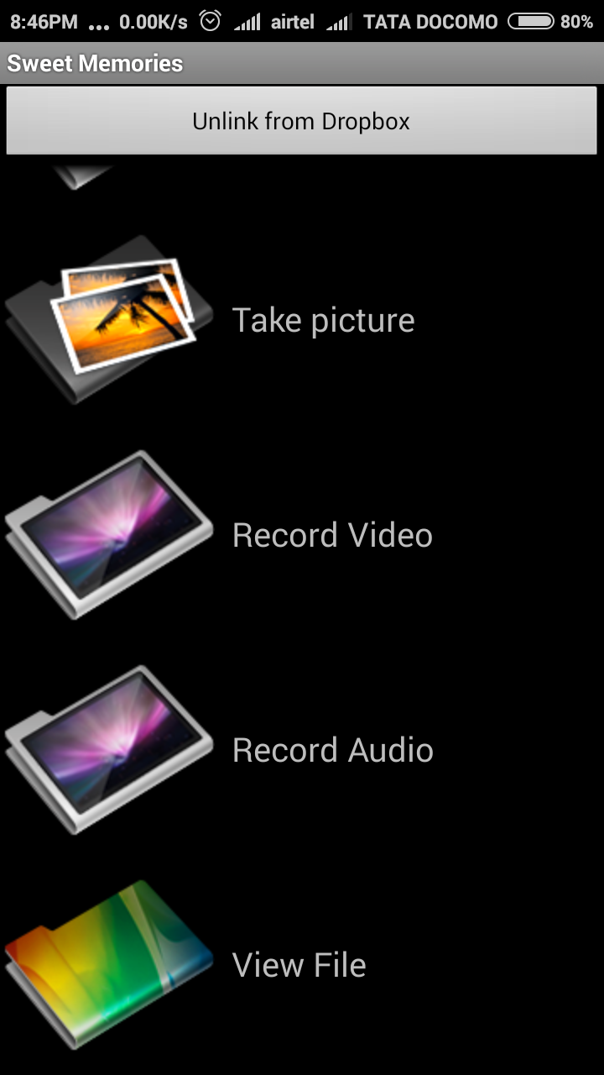

Slide 21
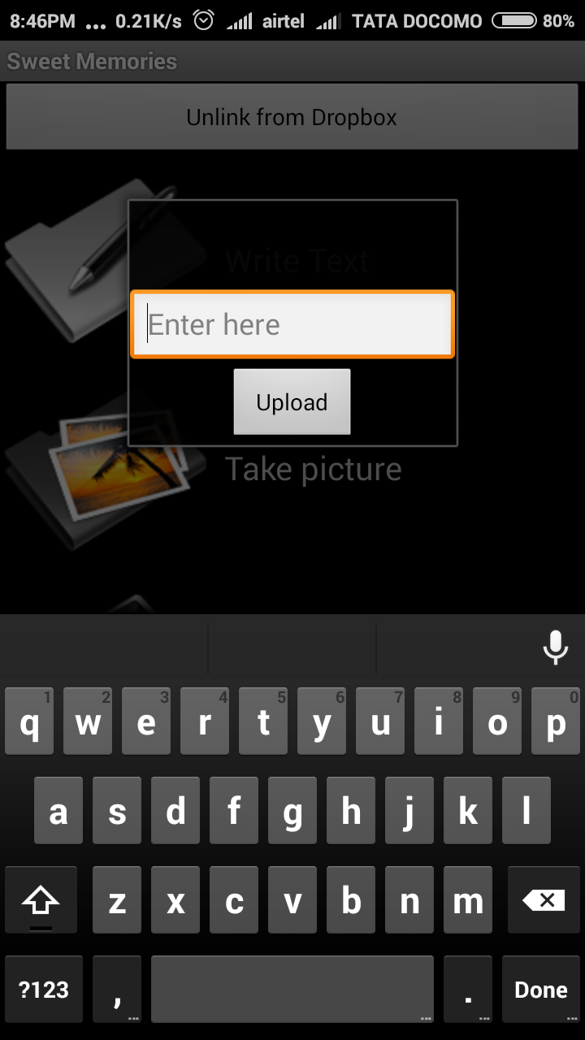

Slide 22
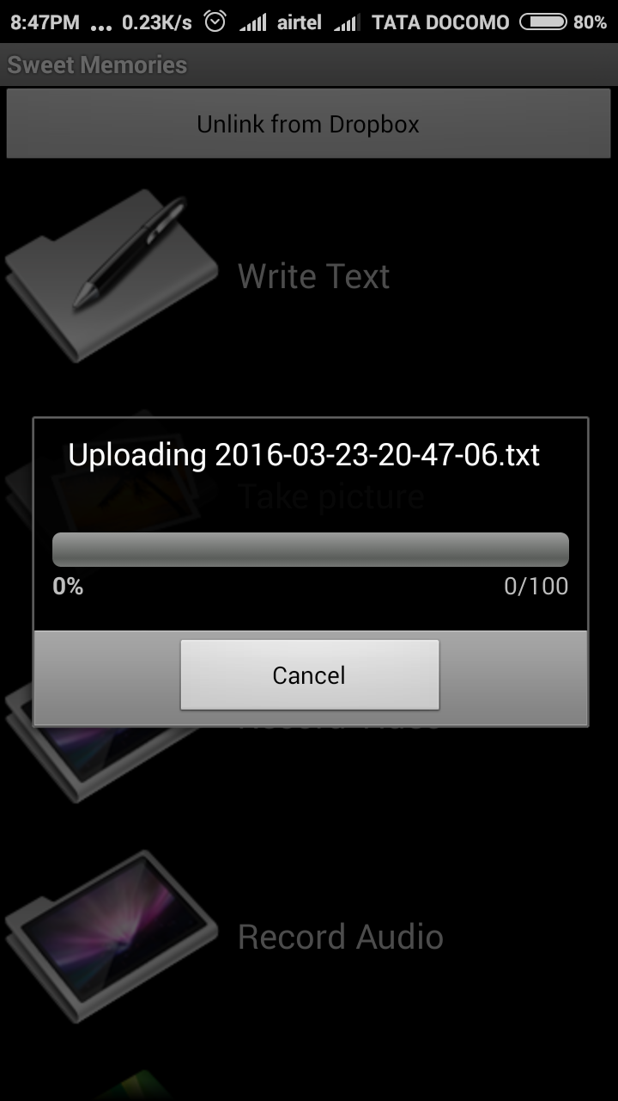

Slide 23
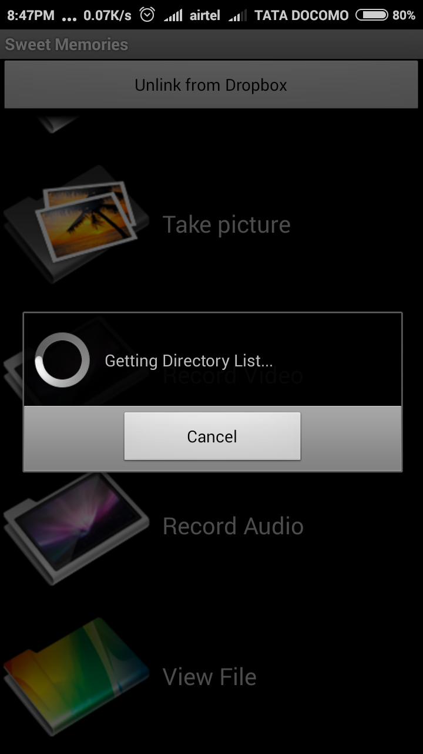

Slide 24
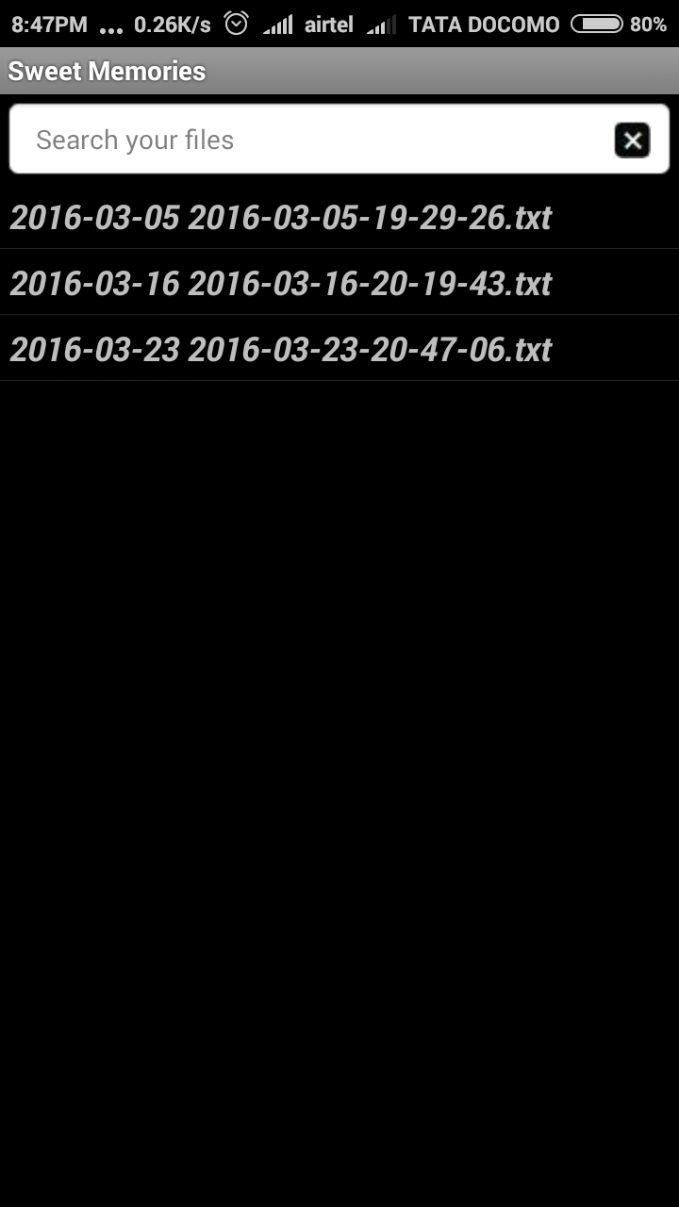

Slide 25
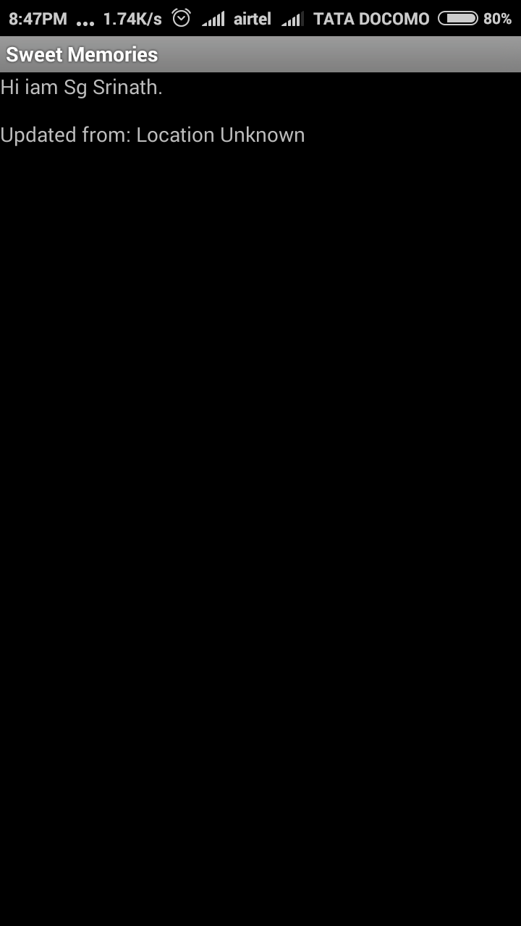

Slide 26
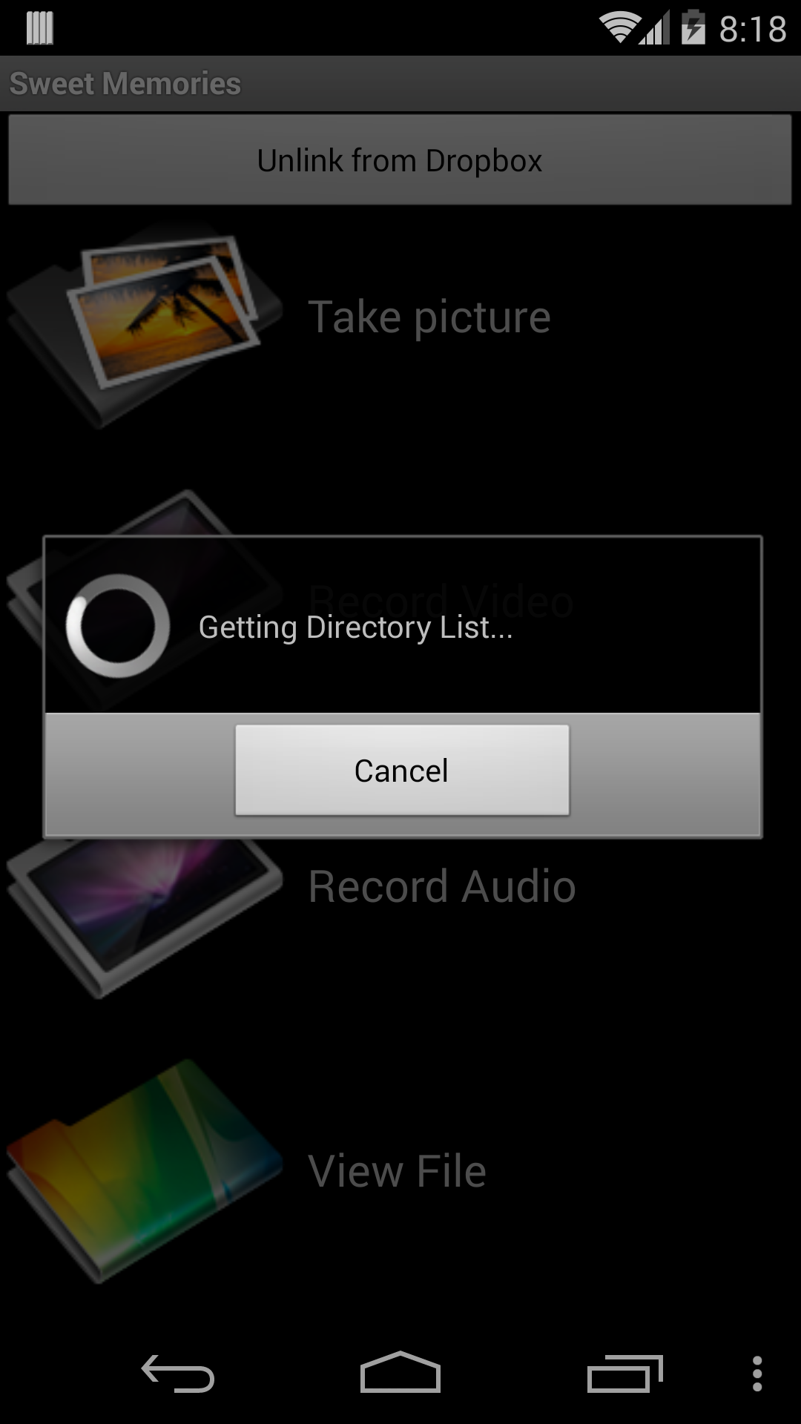

Slide 27
Reference Paper:
I. Kelenyi and J. K. Nurminen, “CloudTorrent - Energy-Efficient BitTorrent Content Sharing for Mobile Devices via Cloud Services,” in Proc.7th IEEE Consumer ommunications and Networking Conf. (CCNC),2010
K. Kumar and Y.-H. Lu, “Cloud Computing for Mobile Users: Can Offloading Computation Save Energy?” Computer, vol. 43, no. 4, pp.51–56, 2010
J. Baliga, R. W. A. Ayre, K. Hinton, and R. S. Tucker, “Green Cloud Computing: Balancing Energy in Processing, Storage, and Transport,” Proceedings of the IEEE, vol. 99, no. 1, pp. 149–167, January 2011
R. Wolski, S. Gurun, C. Krintz, and D. Nurmi, “Using bandwidth Data to Make Computation Offloading Decisions,” in Proc. IEEE Int. Symp. Parallel and Distributed Processing, 2008, pp. 1–8.

Slide 28
Conclusion:
We counsel a novel method for storing a multimedia file like picture, audio, video, text on the cloud to cut number of energy.
Our aftermath display that MCC provides the intelligent phones alongside far multimedia functionality and saves intelligent phone power from 30% to 70%.

Slide 29
THANK YOU!!!

